Slide 1
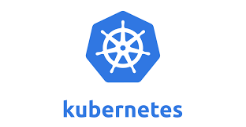
Kubernetes

Slide 2
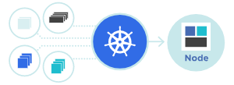


Kubernetes, also known as K8s, is an open-source system for automating deployment, scaling, and management of containerized applications. It groups containers that make up an application into logical units for easy management and discovery. Kubernetes builds upon 15 years of experience of running production workloads at Google, combined with best-of-breed ideas and practices from the community.
Planet Scale
Designed on the same principles that allow Google to run billions of containers a week, Kubernetes can scale without increasing your operations team.
Never Outgrow
Whether testing locally or running a global enterprise, Kubernetes flexibility grows with you to deliver your applications consistently and easily no matter how complex your need is

Slide 3

Run K8s Anywhere
Kubernetes is open source giving you the freedom to take advantage of on-premises, hybrid, or public cloud infrastructure, letting you effortlessly move workloads to where it matters to you.

Slide 4
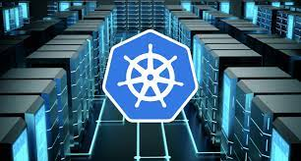
Kubernetes Features
Automated rollouts and rollbacks
Kubernetes progressively rolls out changes to your application or its configuration, while monitoring application health to ensure it doesn't kill all your instances at the same time. If something goes wrong, Kubernetes will roll back the change for you. Take advantage of a growing ecosystem of deployment solutions.
Service discovery and load balancing
No need to modify your application to use an unfamiliar service discovery mechanism. Kubernetes gives Pods their own IP addresses and a single DNS name for a set of Pods, and can load-balance across them.
Storage orchestration
Automatically mount the storage system of your choice, whether from local storage, a public cloud provider such as AWS or GCP, or a network storage system such as NFS, iSCSI, Ceph, Cinder.
Self-healing
Restarts containers that fail, replaces and reschedules containers when nodes die, kills containers that don't respond to your user-defined health check, and doesn't advertise them to clients until they are ready to serve.

Slide 5

Secret and configuration management
Deploy and update secrets and application configuration without rebuilding your image and without exposing secrets in your stack configuration.
Automatic bin packing
Automatically places containers based on their resource requirements and other constraints, while not sacrificing availability. Mix critical and best-effort workloads in order to drive up utilization and save even more resources.
Batch execution
In addition to services, Kubernetes can manage your batch and CI workloads, replacing containers that fail, if desired.
Horizontal scaling
Scale your application up and down with a simple command, with a UI, or automatically based on CPU usage.

Slide 6
IPv4/IPv6 dual-stack
Allocation of IPv4 and IPv6 addresses to Pods and Services
Designed for extensibility
Add features to your Kubernetes cluster without changing upstream source code.

